Slide 1
Photomicrographs of Plant foods
Celery
Permission to reproduce original photomicrographs used to make this collection may be obtained from
Dr. David O. Norris at
david.norris@colorado.edu

Slide 2
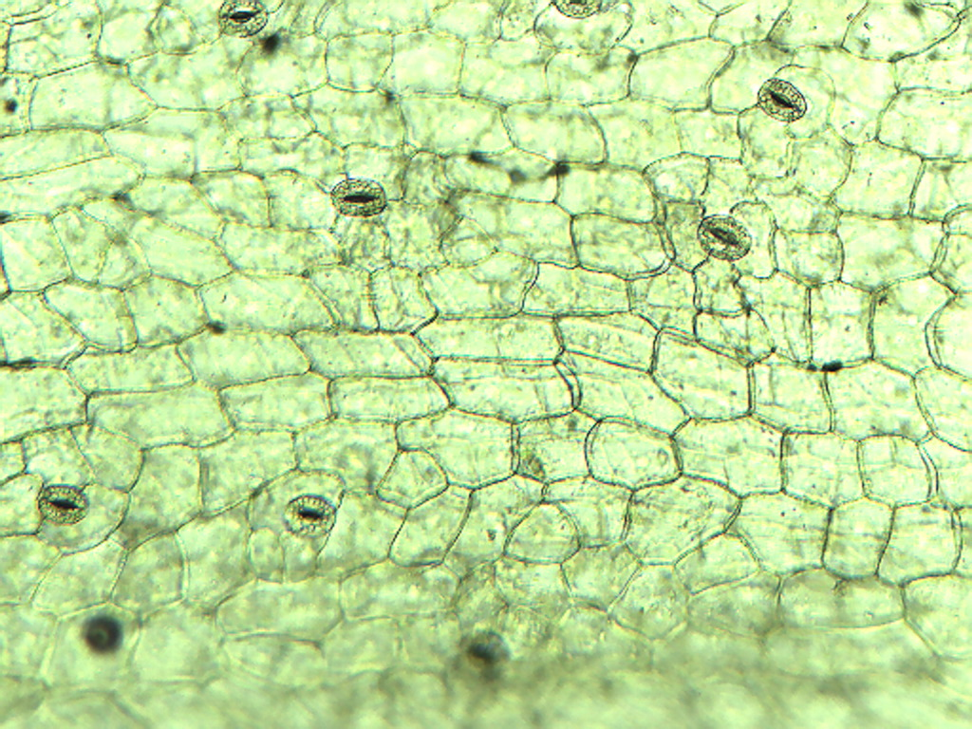
Notes:
124. Apium graeolens L.
Celery. Petiole epidermis with stomates (arrows), 10X.

Slide 3
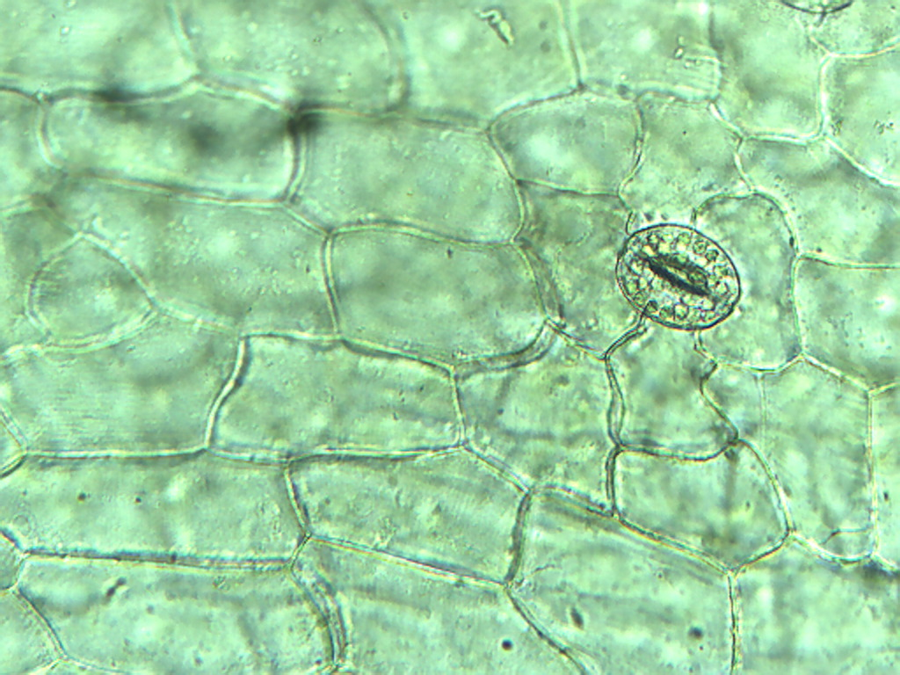
Notes:
125. Celery. Petiole epidermis with one stomate (arrow), 25X

Slide 4
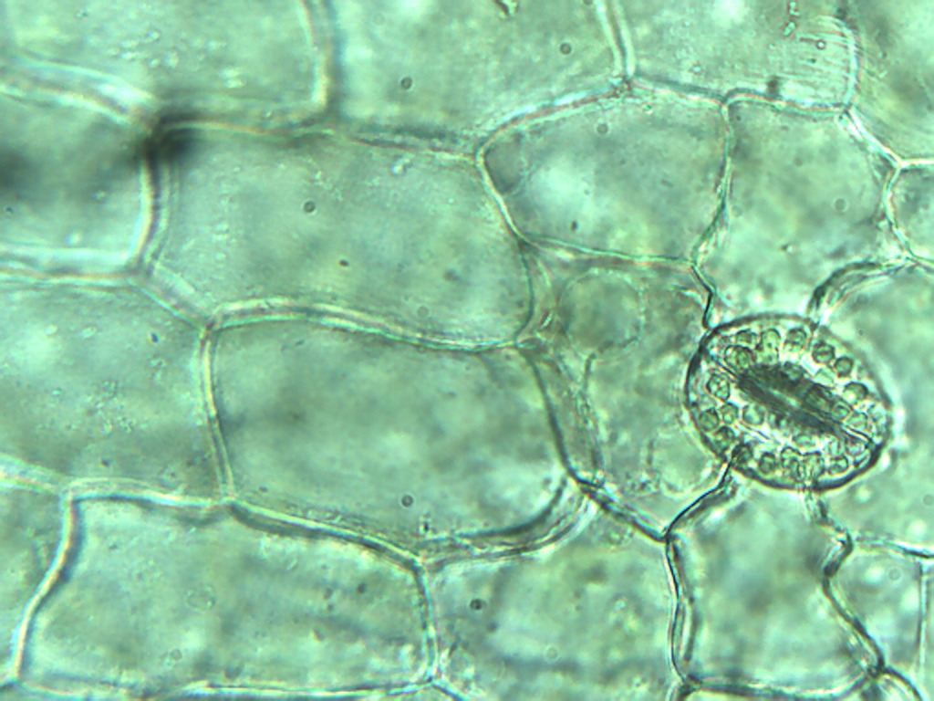
Notes:
126. Celery. Petiole epidermis with stomate showing chloroplasts (arrows) in guard cells, 40X. Note absence of chloroplasts in other epidermal cells.

Slide 5
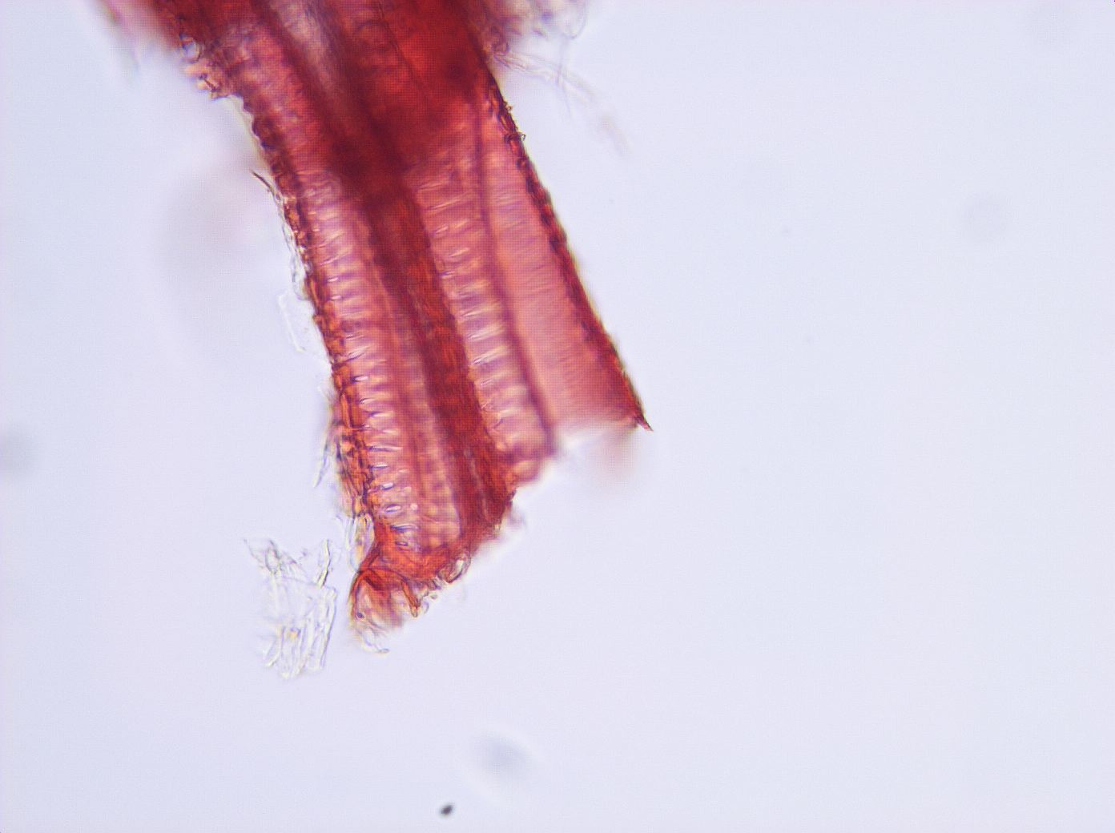
Notes:
127. Celery. Petiole vascular tissue (vessels), stained with safranin, 25X.

